Slide 1
Intro to Linux 2
Team or presenters name
Date:
Location: DUB

Slide 2




Virtual Housekeeping
Use
Headsets
Go on
Mute
Participate Actively
Minimize Distractions
Notes:
***Please ensure you have your headset plugged in so we can avoid echoing and maintain audio quality
***Throughout the session, please keep your mic on mute to avoid background noise during the presentation portions.
***Please be aware you will be asked to participate and engage throughout the session. We ask that you are fully active in the chat box, and are also ready to be called on and unmute if needed. We’ll also have you click on some links to view videos, participate in polls and at some point during the session, we’ll be sending you to specific break out rooms depending on which service you’ll be shadowing.
***Lastly, we ask that you’re fully present. Keeping engaged is even more difficult in a virtual setting, so make sure you turn off notifications, maybe set an out of office in your email. Minimize distractions

Slide 3
Course objectives
Editing text
Displaying text
Processing text
ssh

Slide 4
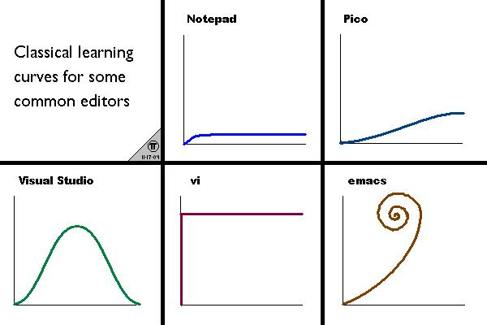
Text Editors
VI/VIM is the most commonly used command line text editor in Linux
vi is default visual editor under Unix, and is therefore shipped with all recent version of Unix
It takes some time to get
familiar with VI but once you
have editing files in linux will
be super quick!!
Notes:
Demonstrate a sample of VI being used
Cover some of the very basic commands/shortcuts
VI commands:
http://www.lagmonster.org/docs/vi.html

Slide 5

Vi/VIM Concepts
Modes (selection):
Normal Mode
Insert Mode
Command line mode
Advanced commands
Navigation
Copy/Pasting
Text Selection/Searching
Count – Do some action “x” times.
Notes:
Discuss VI general concepts:
Normal Mode – Normal Mode is the default mode that you enter when you open VI/VIM used for navigation and moving around the text file that you are editing. (Show some moving around using hjkl(){} You can jump forward and backward by word for example using “w” and “b”, You can also perform larger jumps, by sentence/paragraph etc. Press “i” to enter insert mode. If in doubt press “ESC” to exit back to normal mode.
Insert Mode – Insert Mode is exactly like any other text editor, the keys you press are inserted into the document. Think “Microsoft Word”, “Notepad” or any other text editor. (Example: Get the students to write their name, or show yourself writing your name. Write your name and then press ESC to exit back to insert mode.)
Command line mode– For entering editor commands like :w or :q
Give demo on how to change modes and do simple navigation

Slide 6
Vi mode navigation and basics
vi 123.txt
i for insert mode
ESC for normal mode
: for command line mode
:w to write file
:q to exit file
:q! to exist and discard changes
Notes:
commands are in green to make it clear
Live demo

Slide 7
vi text manipulation
yy yank/copy the current line
3yy (yank 3 lines)
yiw – Yank (copy) the current word (“word” can be relative)
p (paste)
dd delete current line
3dd delete three lines
dw delete word
x delete character
u undo
Notes:
Live demo

Slide 8
Vi moving around
gg goto start of file
SHIFT+G goto end of file
SHIFT+$ goto end of line
Arrow keys for navigation or h,j,k,l
PageUp and PageDown for fast scrolling
/ for searching from top to bottom
? For searching from bottom to top
\c for case insensitive (like error)
Notes:
Live demo

Slide 9
Vi advanced
:r 123.txt to insert external file
:set spell for spell checking
:%s/boring/cool/g to search and replace
vimdiff test1 test2 to compare files
Vi cheat sheet very handy (at the start)
Notes:
Live demo

Slide 10



Display text file
cat – displays the contents of a file
head – displays the first 10 lines of a file
tail – displays the last 10 lines of a file
more – interactive text reader
less – can do more than more ☺
Notes:
Live examples

Slide 11
Manipulate text
sort sorts contents of files in many ways
cut will extract pieces of text
grep powerful tool to search for strings
sed/awk very powerful stream and line editor
wc word count
Notes:
Man commands
man sort
man cut
man grep
man sed
man wc

Slide 12
Practical examples
tail -n 20 -f /var/log/messages
cat /etc/passwd | awk -F ":" '{print $3 ":" $1}’ | sort -nk1 | less
cat /var/log/messages | grep -i error | wc –l
grep -v '^#' /etc/ssh/sshd_config | sed -e /^$/d
Notes:
Displays the last 20 lines of messages continuously
Print user name and UID and sorts by UID
Counts the string error in messages
Print all uncommented lines of ssh config and gets rid of empty lines Mentioned regular expression and their power

Slide 13
Find and locate
Locate searches in a DB file updated daily
Find command can sometime take a long time to scan all of the data.
time find / -name "httpd.conf” # running for minutes
time locate "httpd.conf” # real 0m0.049s
Notes:
https://www.thegeekdiary.com/whats-the-difference-between-locate-and-find-command-in-linux/

Slide 14
ssh (secure shell)

Slide 15
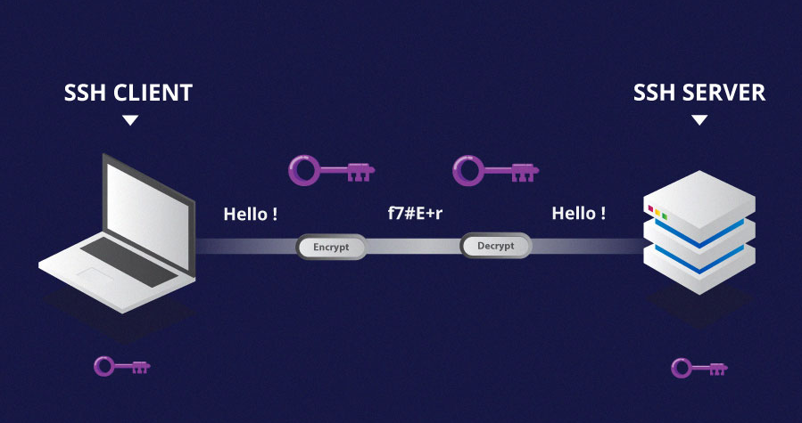
ssh
Secure shell used to establish remote connection
Port 22
Authentication and Encryption
Works via password/key files/AD integration (sssd)
Notes:
Explain ssh basics
Mention telnet as a troubleshooting tool
Mention SSM session manager and EC2 instance connect just for reference

Slide 16
ssh configuration
/etc/ssh/sshd_config
~/.ssh/authorized_keys:
ssh-rsa uBBi+[…]vot2s comment
private/public key pair
Tools like rsync/scp/sftp use ssh
Notes:
main config file located at /etc/ssh/sshd_config
authorized_keys do determine public keys used for passwordless authentication
Mention advanced features like port forwarding as well

Slide 17
Troubleshooting ssh
Probably the number one case driver in linux
ssh or network issue? (telnet/nc/ssh –vvv)
Get the specific error message
Most common: permissions, user, pem file, firewall, authorized_keys malformed, other system issue
Notes:
explain some common ssh troubleshooting scenarios
important to find out if this is indeed an ssh or a simple network issue
the error message in ssh via the verbose option will give you more information
common issues:
wrong permissions of config files
wrong user supplied
wrong pem file supplied
firewall in place (SG/NACL/OS firewall)
authorized_keys file malformed
main config file malformed or wrongly configured
https://docs.aws.amazon.com/AWSEC2/latest/UserGuide/TroubleshootingInstancesConnecting.html

Slide 18
You should now be familiar with…
Editing files
Displaying text files
Processing text
ssh

Slide 19
Practical Exercise 1
create a new text file with vi
input the following three lines: All work and no play makes Jack
a dull boy 3) switch to command mode, delete the second line, undo the change 4) write the file, exit vi 5) add a third line via echo to the file, display the contents of the file 6) goto /var/log display all lines of messages/syslog containing "error/ERROR" display the last 20 lines of messages/syslog
Notes:
https://docs.aws.amazon.com/AWSEC2/latest/UserGuide/AccessingInstances.html

Slide 20
Insist on the highest standards
Please take 2 minutes to complete the survey to let us know what you liked about the training and what can be improved.
This will help us to continue creating helpful and relevant training content.
Link is in the invitation email.

